Slide 1
LABA: Design analysis
110061519 楊博舜

Slide 2
Outline
Briefly introduction to the algorithm or overall system
Explain the original code/system/pragmas and how you implement it
Examine the synthesis log to list what steps the tool takes during synthesis
Analyze the timing/performance/utilization
If possible, share how you optimize the design and the trade-off you make
Explain what you observed and learned
Two questions to test the key learning

Slide 3
Briefly Introduction to the Algorithm or Overall System

Slide 4
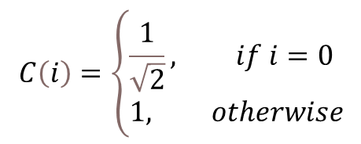
Briefly introduction to the algorithm or overall system
In this tutorial, we are going to learn how to use Vitis HLS to build, analyze, and optimize a hardware kernel. There are a few ways to do it, such as pipelining, using dual-port RAMs, array partitioning, and dataflow optimization.
The algorithm implemented in hardware is discrete cosine transform, DCT. It can process data into frequency domain, similar to Fourier transform. What makes them different is that DCT only uses real numbers. DCT is often used to process signals and images. Assume that we have a matrix with size N×N, and the values are denoted by f(x,y). The formula is shown below.
$$D\left(i,j\right)=\frac{1}{2\sqrt{2N}}C\left(i\right)C\left(j\right)\sum_{x=0}^{N−1}{\sum_{y=0}^{N−1}{f\left(x,y\right)\cos{\frac{\left(2x+1\right)iπ}{2N}}\cos{\frac{\left(2y+1\right)jπ}{2N}} }}$$
$$C\left(i\right)=\left\{\begin{aligned}&\frac{1}{\sqrt{2}}, if i=0 \\ &1, otherwise\end{aligned}\right.$$

Slide 5
Explain the Original Code/System/Pragmas and How You Implement It

Slide 6
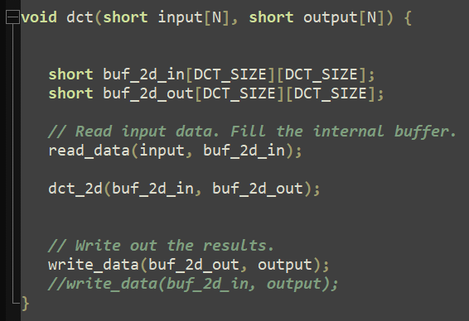
Explain the Original Code/System/Pragmas and How You Implement It
This is the top function. It is obvious that the kernel will read data, process the data, and then write the data. Note that DCT_SIZE is specified as 8 in the design.

Slide 7
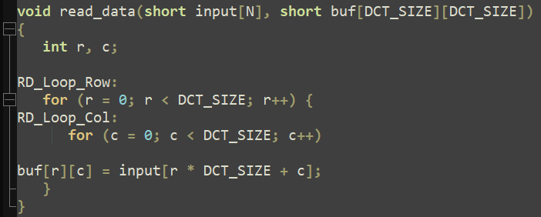
Explain the Original Code/System/Pragmas and How You Implement It
This is the function that reads data. We can see that it reads a 1d array into a 2d array.

Slide 8
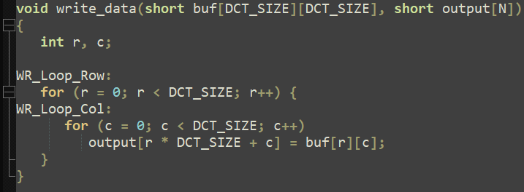
Explain the Original Code/System/Pragmas and How You Implement It
This is the function that writes data. We can see that it writes a 2d array into a 1d array.

Slide 9
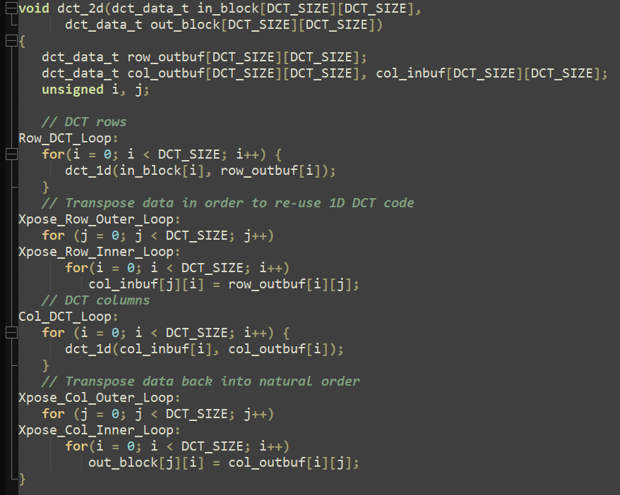
Explain the Original Code/System/Pragmas and How You Implement It
This is the core function of DCT algorithm. The function is further divided into 4 parts, processing row, transposing, processing column, and transposing again. In this way, they can reuse the same function.

Slide 10
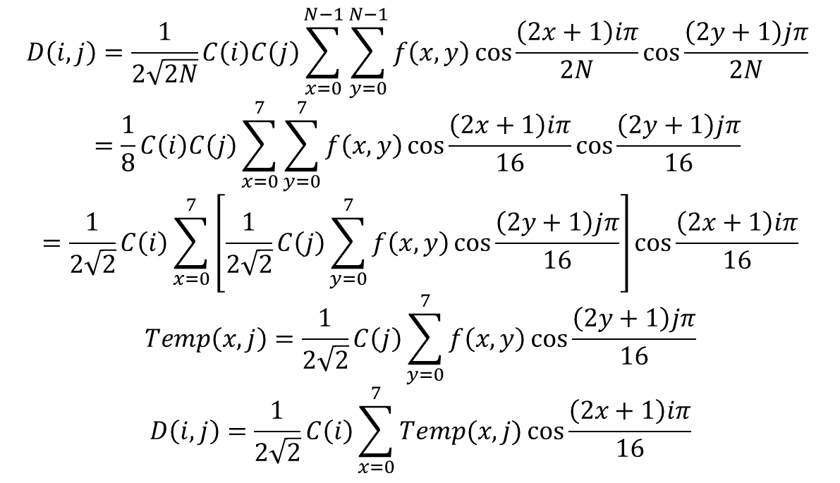
Explain the Original Code/System/Pragmas and How You Implement It
Here, I will show how they divide the formula into row and column steps with N=8.
We can see that the formula has the similar operation for sum over x and sum over y. They declare another function to do the operation row by row, and transpose is required.
$$D\left(i,j\right)=\frac{1}{2\sqrt{2N}}C\left(i\right)C\left(j\right)\sum_{x=0}^{N−1}{\sum_{y=0}^{N−1}{f\left(x,y\right)\cos{\frac{\left(2x+1\right)iπ}{2N}}\cos{\frac{\left(2y+1\right)jπ}{2N}} }}$$
$$=\frac{1}{8}C\left(i\right)C\left(j\right)\sum_{x=0}^{7}{\sum_{y=0}^{7}{f\left(x,y\right)\cos{\frac{\left(2x+1\right)iπ}{16}}\cos{\frac{\left(2y+1\right)jπ}{16}} }}$$
$$=\frac{1}{2\sqrt{2}}C\left(i\right)\sum_{x=0}^{7}{\left[\frac{1}{2\sqrt{2}}C\left(j\right)\sum_{y=0}^{7}{f\left(x,y\right)\cos{\frac{\left(2y+1\right)jπ}{16}}}\right]\cos{\frac{\left(2x+1\right)iπ}{16}}}$$
$$Temp\left(x,j\right)=\frac{1}{2\sqrt{2}}C\left(j\right)\sum_{y=0}^{7}{f\left(x,y\right)\cos{\frac{\left(2y+1\right)jπ}{16}}}$$
$$D\left(i,j\right)=\frac{1}{2\sqrt{2}}C\left(i\right)\sum_{x=0}^{7}{Temp(x,j)\cos{\frac{\left(2x+1\right)iπ}{16}}}$$

Slide 11
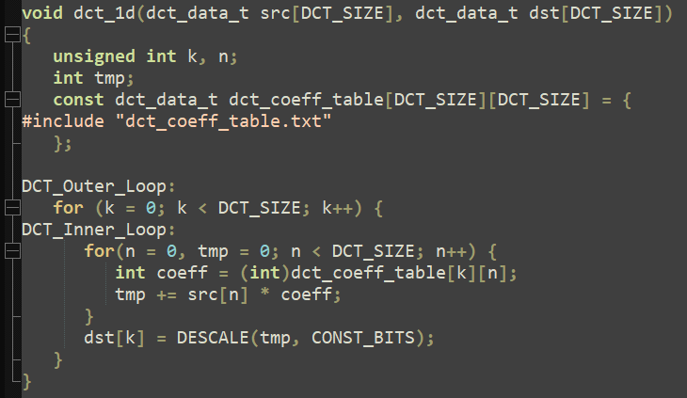
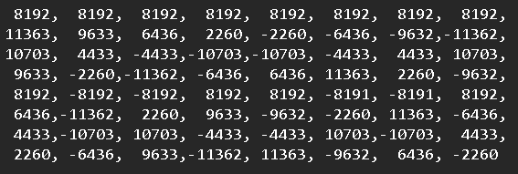
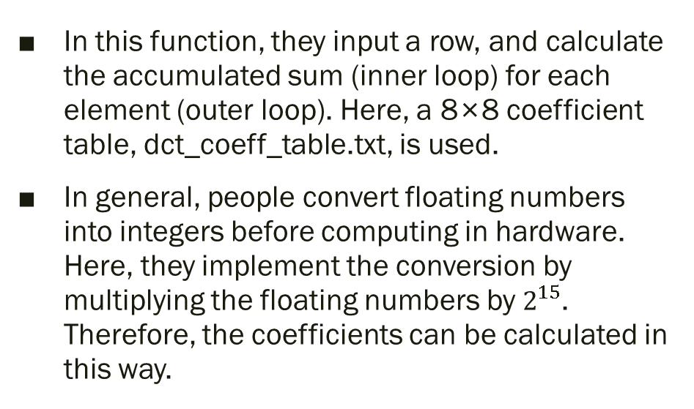

Explain the Original Code/System/Pragmas and How You Implement It
In this function, they input a row, and calculate the accumulated sum (inner loop) for each element (outer loop). Here, a 8×8 coefficient table, dct_coeff_table.txt, is used.
In general, people convert floating numbers into integers before computing in hardware. Here, they implement the conversion by multiplying the floating numbers by $2^{15}$. Therefore, the coefficients can be calculated in this way.
$$Coef\left(j,y\right)=\frac{1}{2\sqrt{2}}C\left(j\right)\cos{\frac{\left(2y+1\right)jπ}{16}}×2^{15}$$

Slide 12
Examine the Synthesis Log to List What Steps the Tool Takes During Synthesis

Slide 13
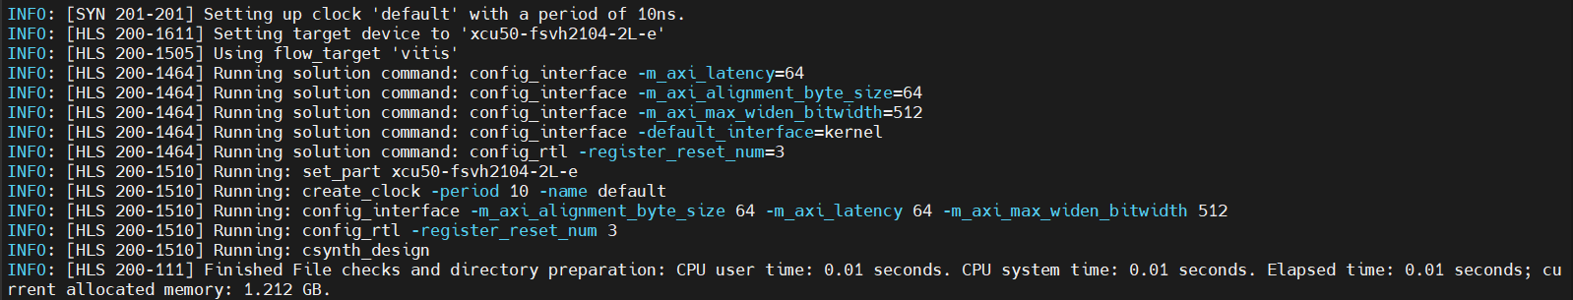
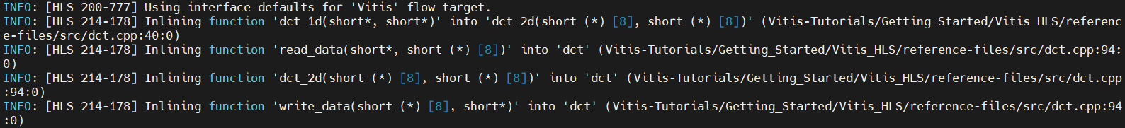
Project and solution initialization loads source and constraints files, and configures the active solution for synthesis.
Start compilation reads source files into memory.
Interface detection and setup reviews and generates port and block interfaces for the function.
Burst read and write analysis for ports/interfaces.

Slide 14
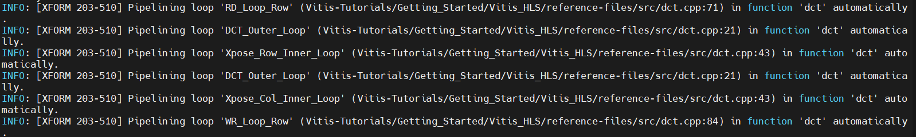
Compiler transforms code to operations.
Performs Synthesizeability checks.
Automatic pipelining of loops at tripcount threshold.

Slide 15
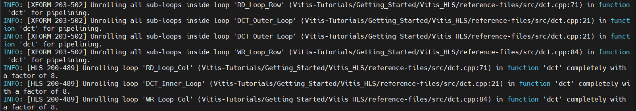
Unrolling loops, both automatic and user-directed.
Array partitioning.
Balance expressions using associative and commutative properties.
Loop flattening to reduce loop hierarchy.

Slide 16
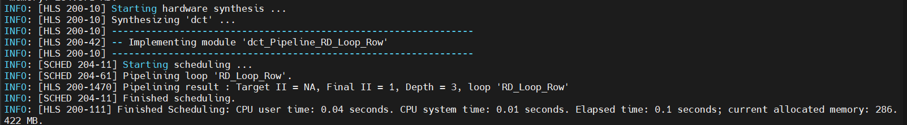
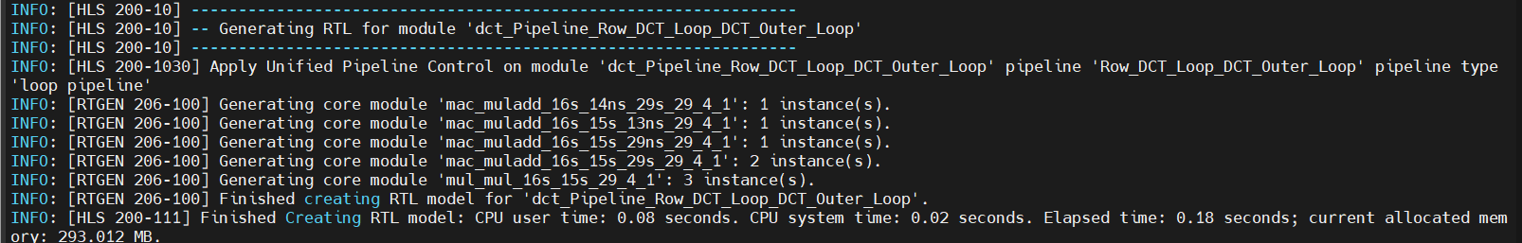
Partial write detection (writing part of a memory word)
Finish architecture synthesis, start scheduling.
End scheduling, generate RTL code.

Slide 17
Analyze the Timing/Performance/Utilization

Slide 18
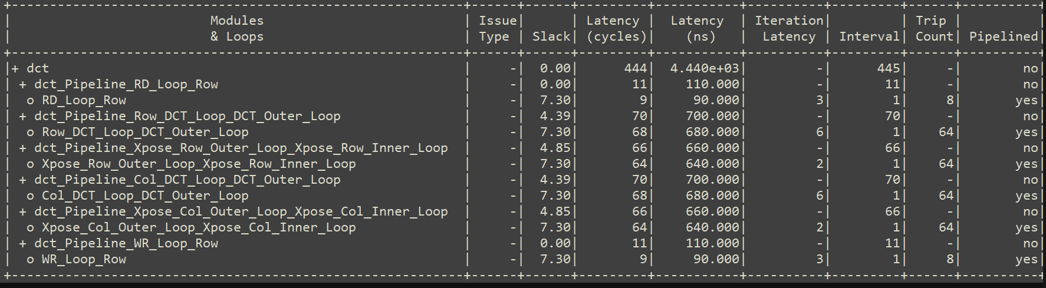
Performance Profile
This is the latency/loop table resulting from the original setting in the tutorial. To see how it calculate the latency of loops, I disable the pipeline of RD_Loop_Row. The result is shown in the next page.

Slide 19
Performance Profile
We can see that if a loop is pipelined, the latency is small. The value is approximately Iteration Latency+Interval×(Trip Count-1)=10. If a loop is not pipelined, the latency is large. The value is Iteration Latency×Trip Count=104.
From the latency table, we can also see that the critical blocks to optimize are the dct_Pipeline_Row_DCT_Loop_DCT_Outer_Loop and dct_Pipeline_Col_DCT_Loop_DCT_Outer_Loop, since their latency are largest. This can also be seen on Function Call Graph Viewer by setting heat map.

Slide 20
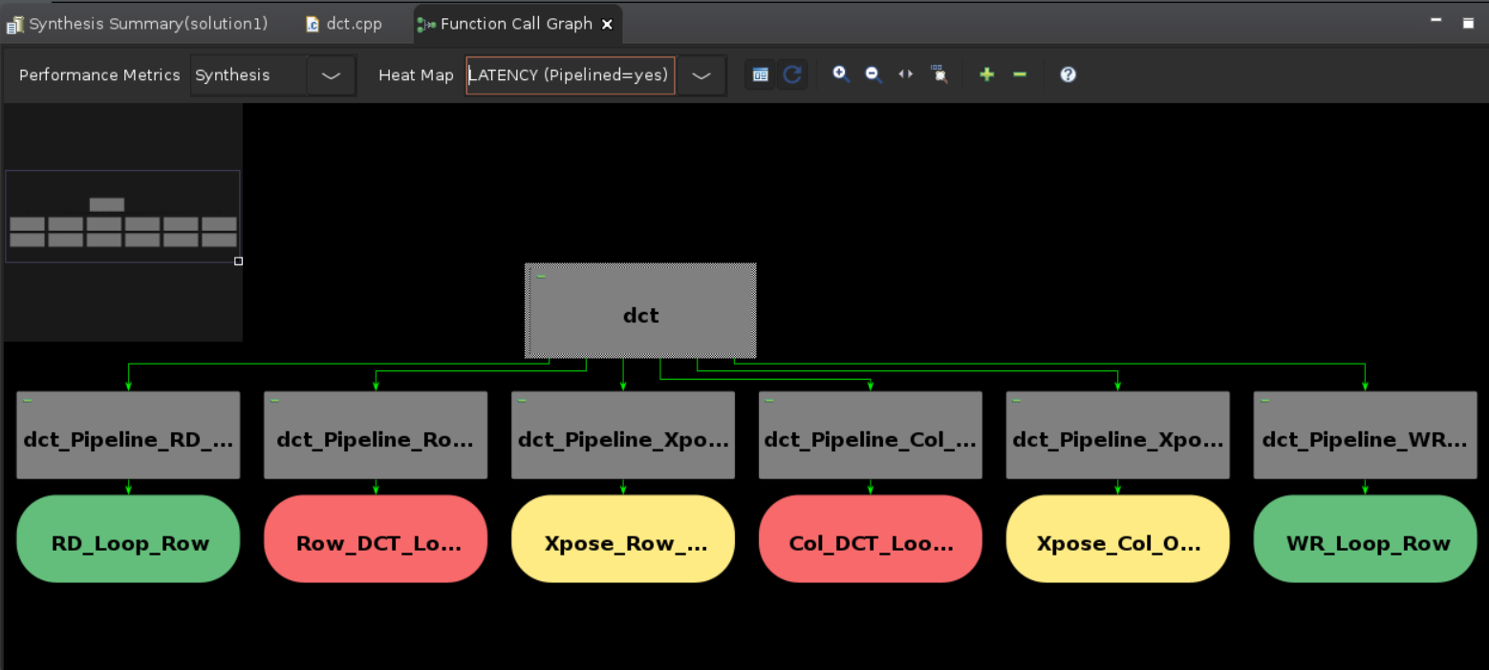
Function Call Graph Viewer

Slide 21
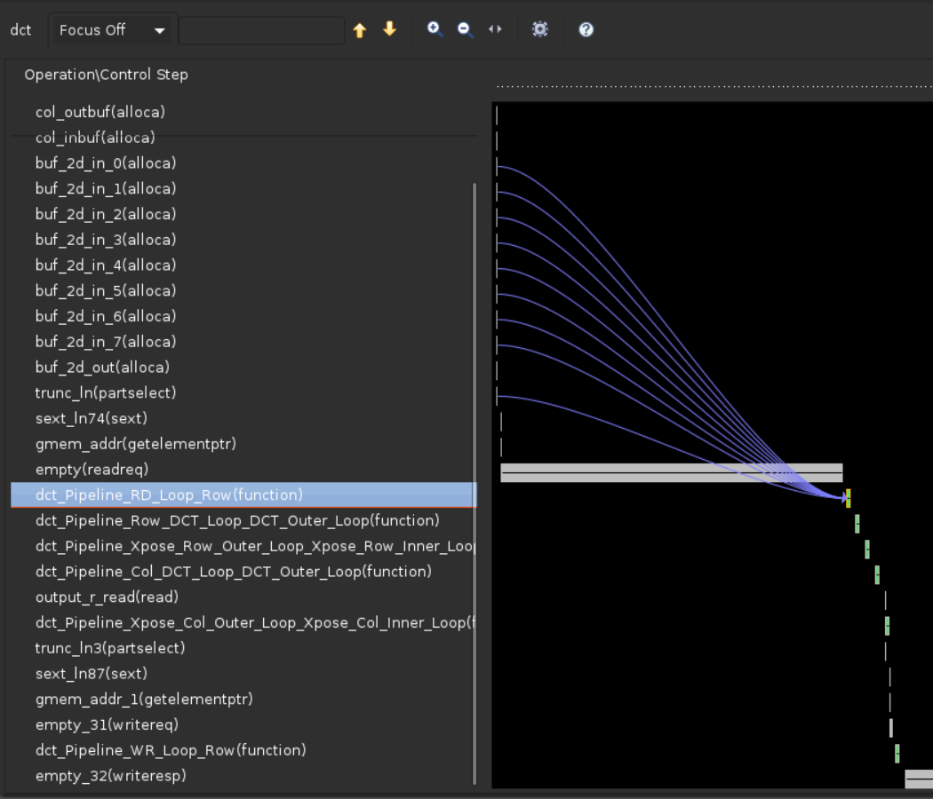
Schedule Viewer
From the viewer of the top module, we can find those modules introduced above, and they are arranged in order. We can also see some blue lines representing the data dependencies.

Slide 22
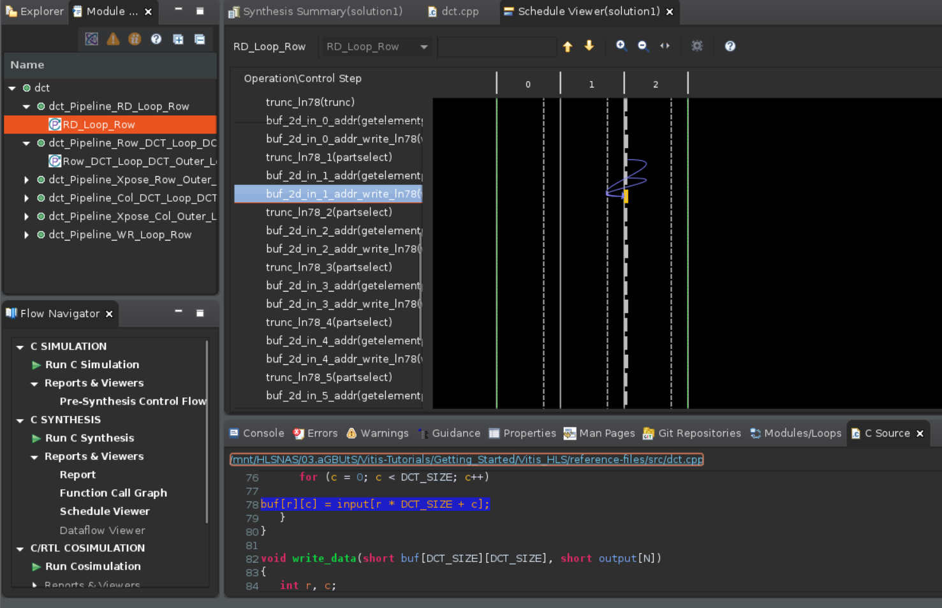
Schedule Viewer
From the module hierarchy, we can select the modules and loops to view their schedule. Besides, we can also right click on the operation to see where it was called.

Slide 23
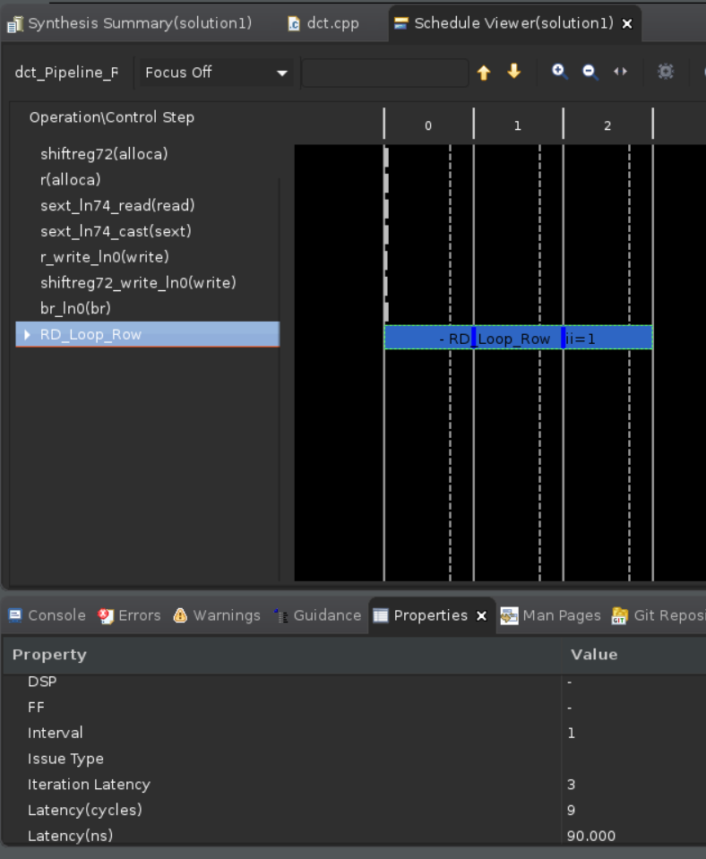
Schedule Viewer
From the properties, we can also see the latency of selected operation.

Slide 24
If Possible, Share How You Optimize the Design and the Trade-off You Make

Slide 25
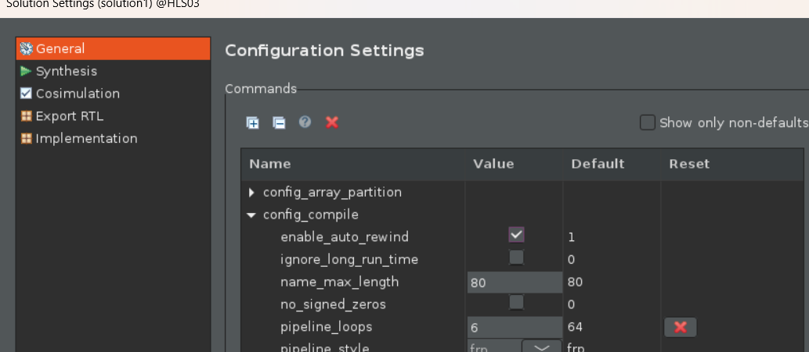
Configure the Pipeline Loops Threshold
In this method, we are asked to modify pipeline_loops as 6. It enables loops with an iteration count below 6 to be pipelined automatically.

Slide 26
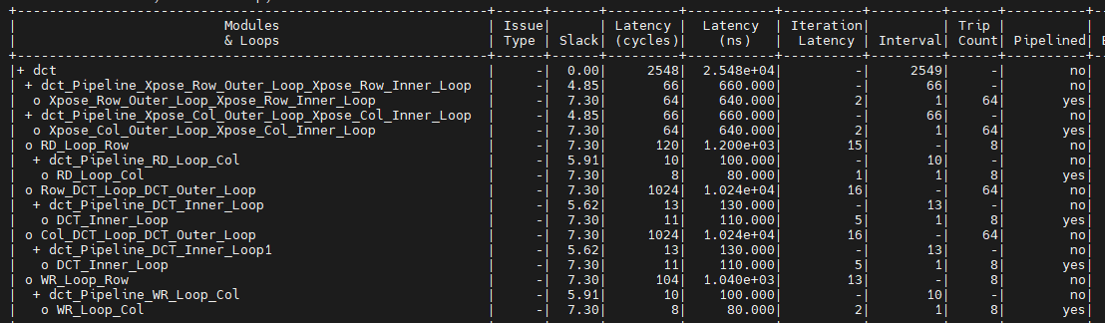
Configure the Pipeline Loops Threshold
After synthesis, we can see that the latency increases a lot, and that many loops are not pipelined, resulting to large latency. By the way, increasing the value does not help in this case, since there is no loop with iteration counter larger than the default value, 64.

Slide 27
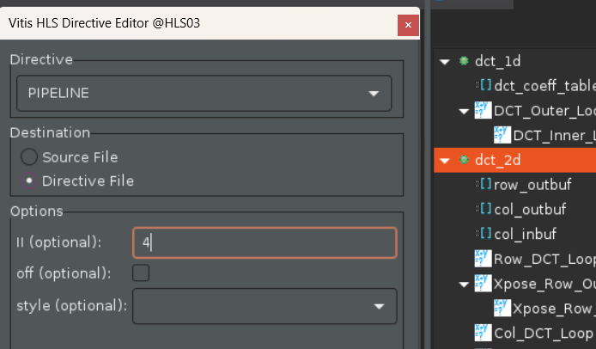
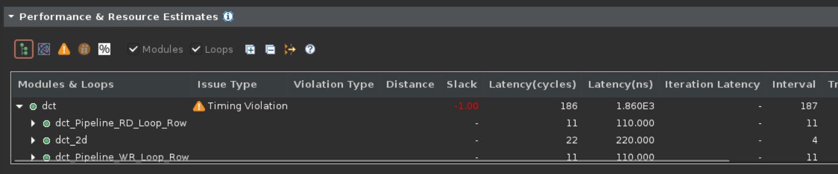
Configure the Pipeline Initiation Interval
In the tutorial, we are asked to modify the II of dct_2d as 4.
After synthesis, although the overall latency is decreased, there is timing violation.

Slide 28
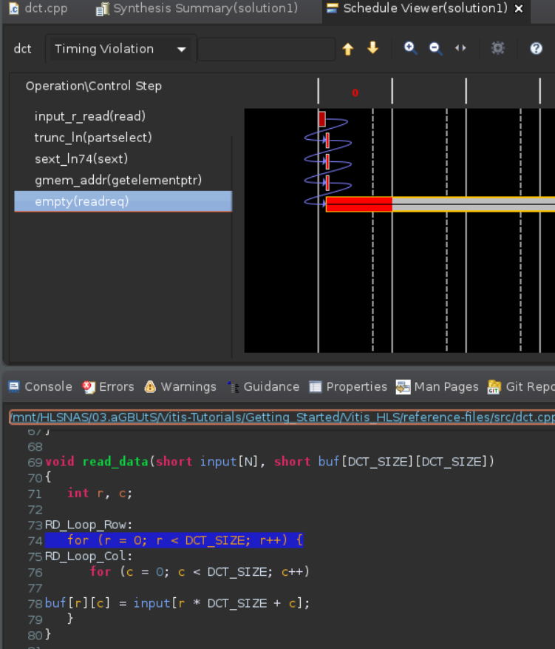
Configure the Pipeline Initiation Interval
We can see that the timing violation occurred during reading data. I tried to figure out how to fix it by adding some directives, but end up failing.

Slide 29
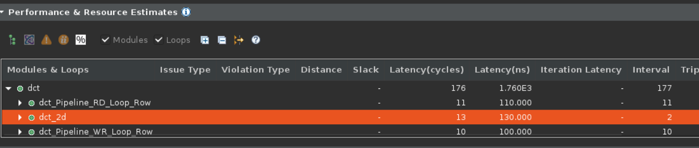
Configure the Pipeline Initiation Interval
I tried to modify the II as 2, and it works well. The figure above is the result performance. We can see that the latency is greatly decreased.

Slide 30
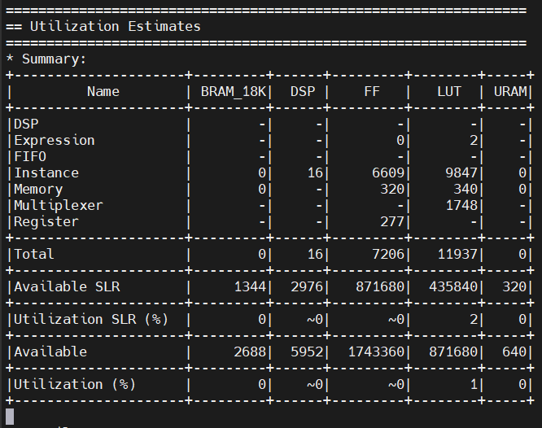
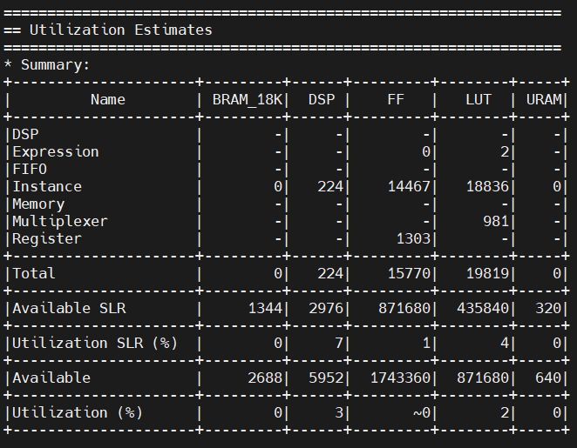
Configure the Pipeline Initiation Interval
Take a look at the memory utilization, and we can see the tradeoff.
It consumes much more memory compared to the original method.
Original method | This optimization method

Slide 31
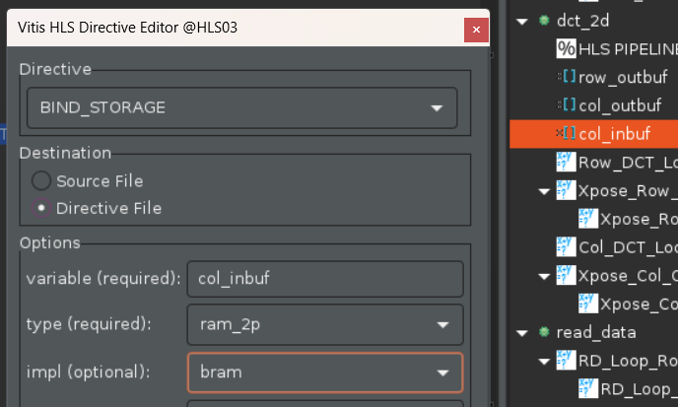
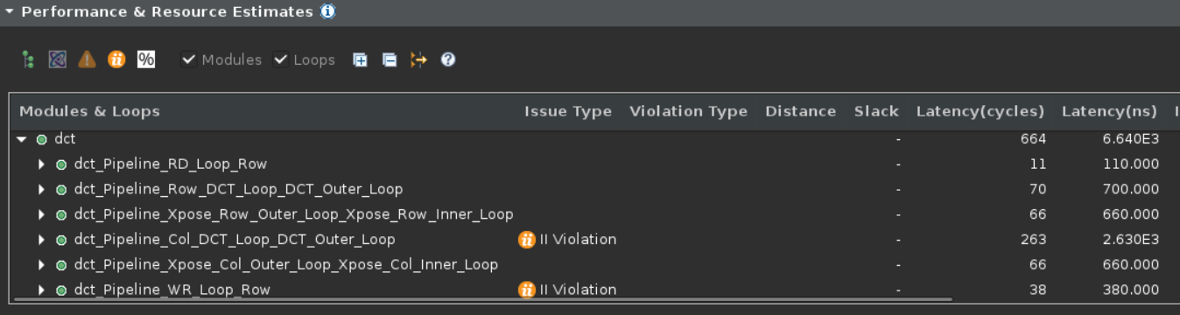
Assign Dual-port RAMs with BIND_STORAGE
In the tutorial, we are asked to use BRAMs to store col_inbuf and buf_2d_out. After synthesis, the result is shown in the figure below.
We can see that the total latency increases a lot. Besides, II violation is issued (II violation does not influence the co-simulation result. In HLS, II violation will be issued if II is not 1.)

Slide 32
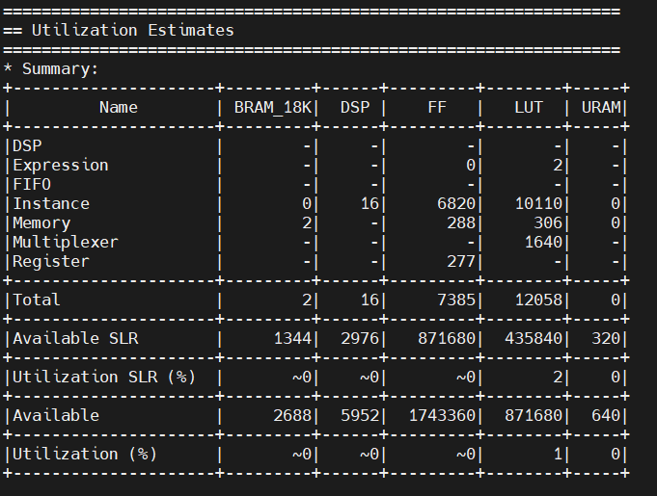
Assign Dual-port RAMs with BIND_STORAGE
Take a look at the report, and we can see that it uses more resource as well. Therefore, I think that this method is not for this application.
Original method | This optimization method

Slide 33
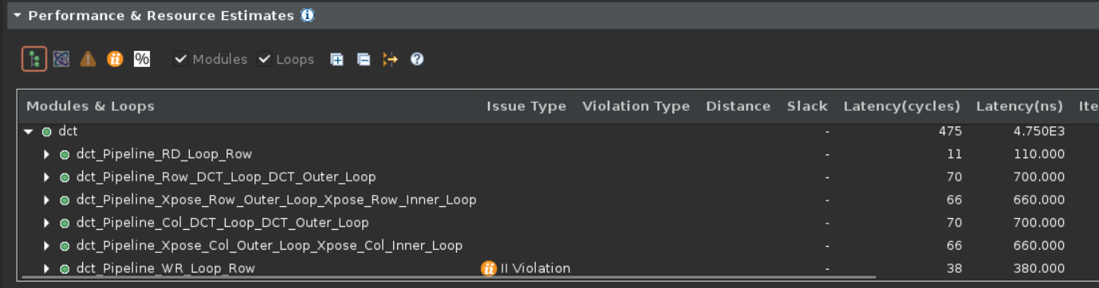
Assign Dual-port RAMs with BIND_STORAGE
I also tried to remove the II violation. I think that violation happened since the bandwidth of BRAM is not large enough. Therefore, I try to partition the array (the next optimization method). The result is shown below.
We can see that the latency is reduced (664 -> 475), but still larger than that of the original method (444). To remove the II violation of writing output, I enlarge the II of WR_Loop_ROW as 2. The result is shown in the next page.

Slide 34
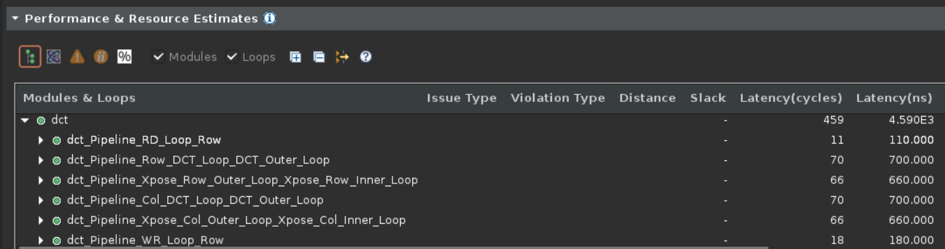
Assign Dual-port RAMs with BIND_STORAGE
No II violation is issued, and the latency decreases a little (still larger than that of the original method).

Slide 35
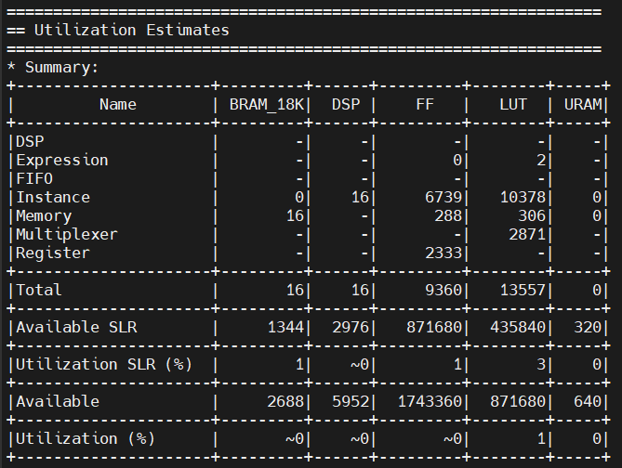
Assign Dual-port RAMs with BIND_STORAGE
Again, compare their utilization, and we can see that the original method looks better.
Original method | This optimization method

Slide 36
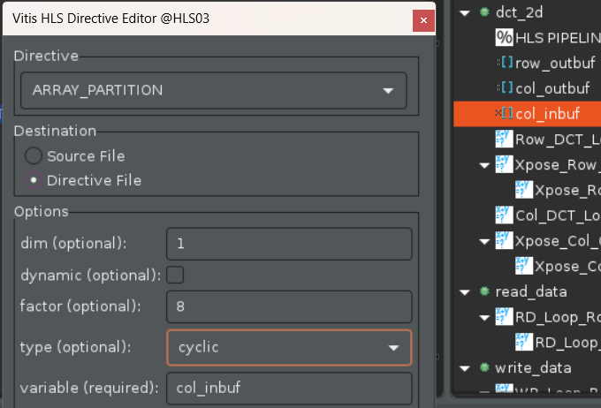
Assign an Array Partition
In the tutorial, we are asked to partition the arrays, col_inbuf and buf_2d_out.

Slide 37
Assign an Array Partition
We can see that the iteration latency of WR_Loop_Row decreases. However, I have no idea why the overall latency increases.

Slide 38
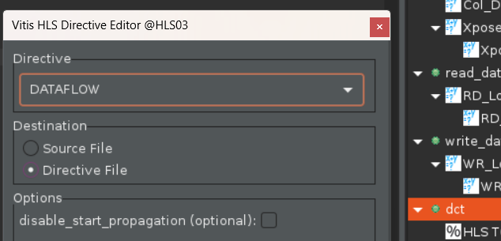
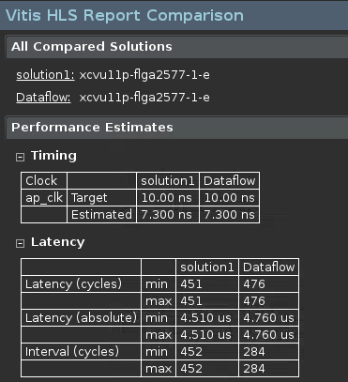
Dataflow Optimization
In the tutorial, we are asked to add pragma DATAFLOW to the directives. This pragma enables task-level pipelining. The HLS tool will analyze the dataflow between functions and see whether they can overlap or not. The comparison result is shown in the figure below.

Slide 39
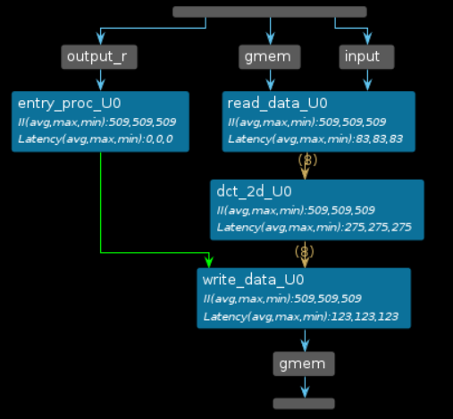
Dataflow Optimization
After running co-simulation, we can see the dataflow graph on the left and the process table in the next page, we can see some information about II and latency.

Slide 40
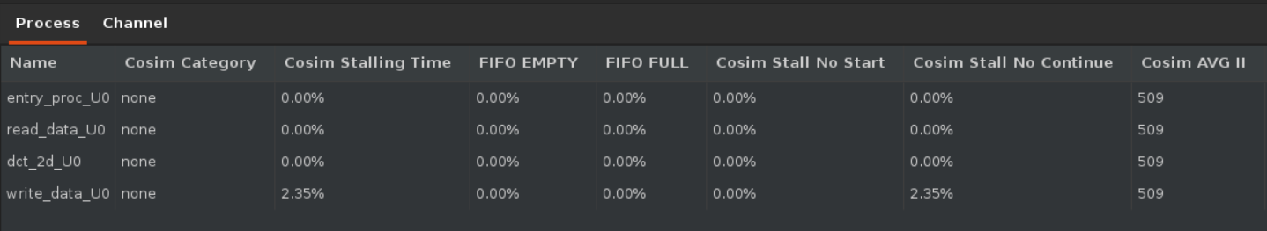
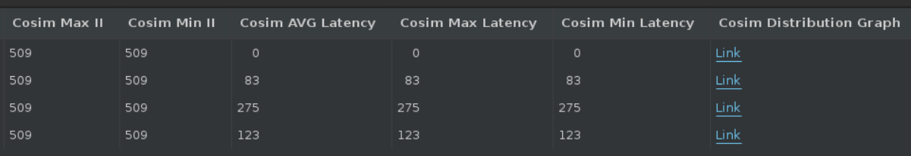
Dataflow Optimization
From the process table below, we can see some information.

Slide 41
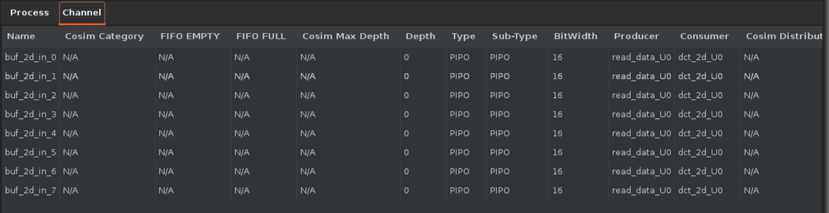
Dataflow Optimization
From the channel table below, we can see the channel type and the bit width.

Slide 42
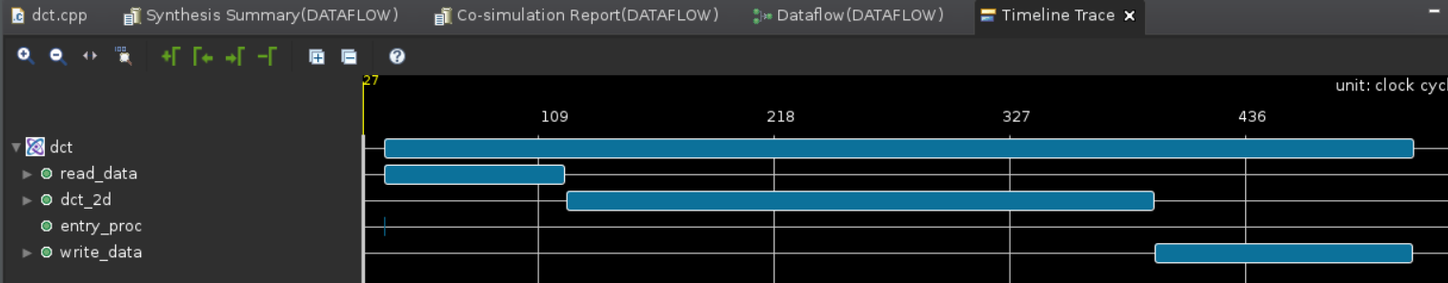
Dataflow Optimization
We can also take a look at the timeline trace. We can see that the 3 functions do not execute in parallel.

Slide 43
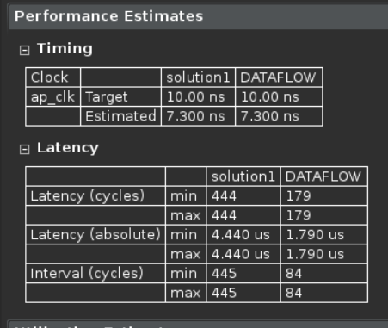
Dataflow Optimization
Can it be further optimized? I tried the pipeline method taught in second method, and removed the array partitioning. The result is shown in the figure.
We can see that the interval is now only 84.

Slide 44
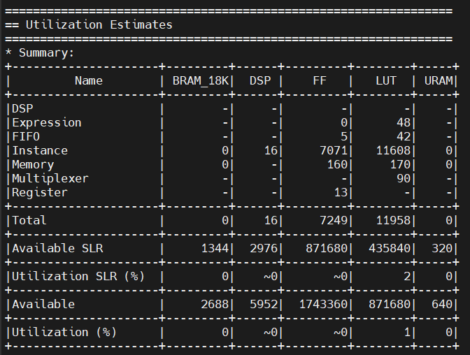
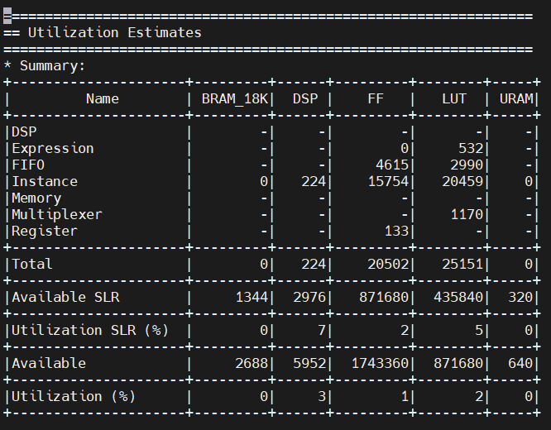
Dataflow Optimization
Again, take a look at the memory utilization, and we can see that it consumes much more resources.
Original method | This optimization method

Slide 45
Explain What You Observed and Learned

Slide 46
Explain What You Observed and Learned
In this lab, I learned some tools to help us analysis our design, such as schedule viewer, function call graph, and dataflow viewer. I also learned some optimization methods, such as pipelining, using dual-port RAMs, array partitioning, and dataflow optimization.

Slide 47
Two questions to test the key learning

Slide 48
Two questions to test the key learning
How can we add directives?
What can be the tradeoff for lower latency?

Slide 49
END

